Slide 1
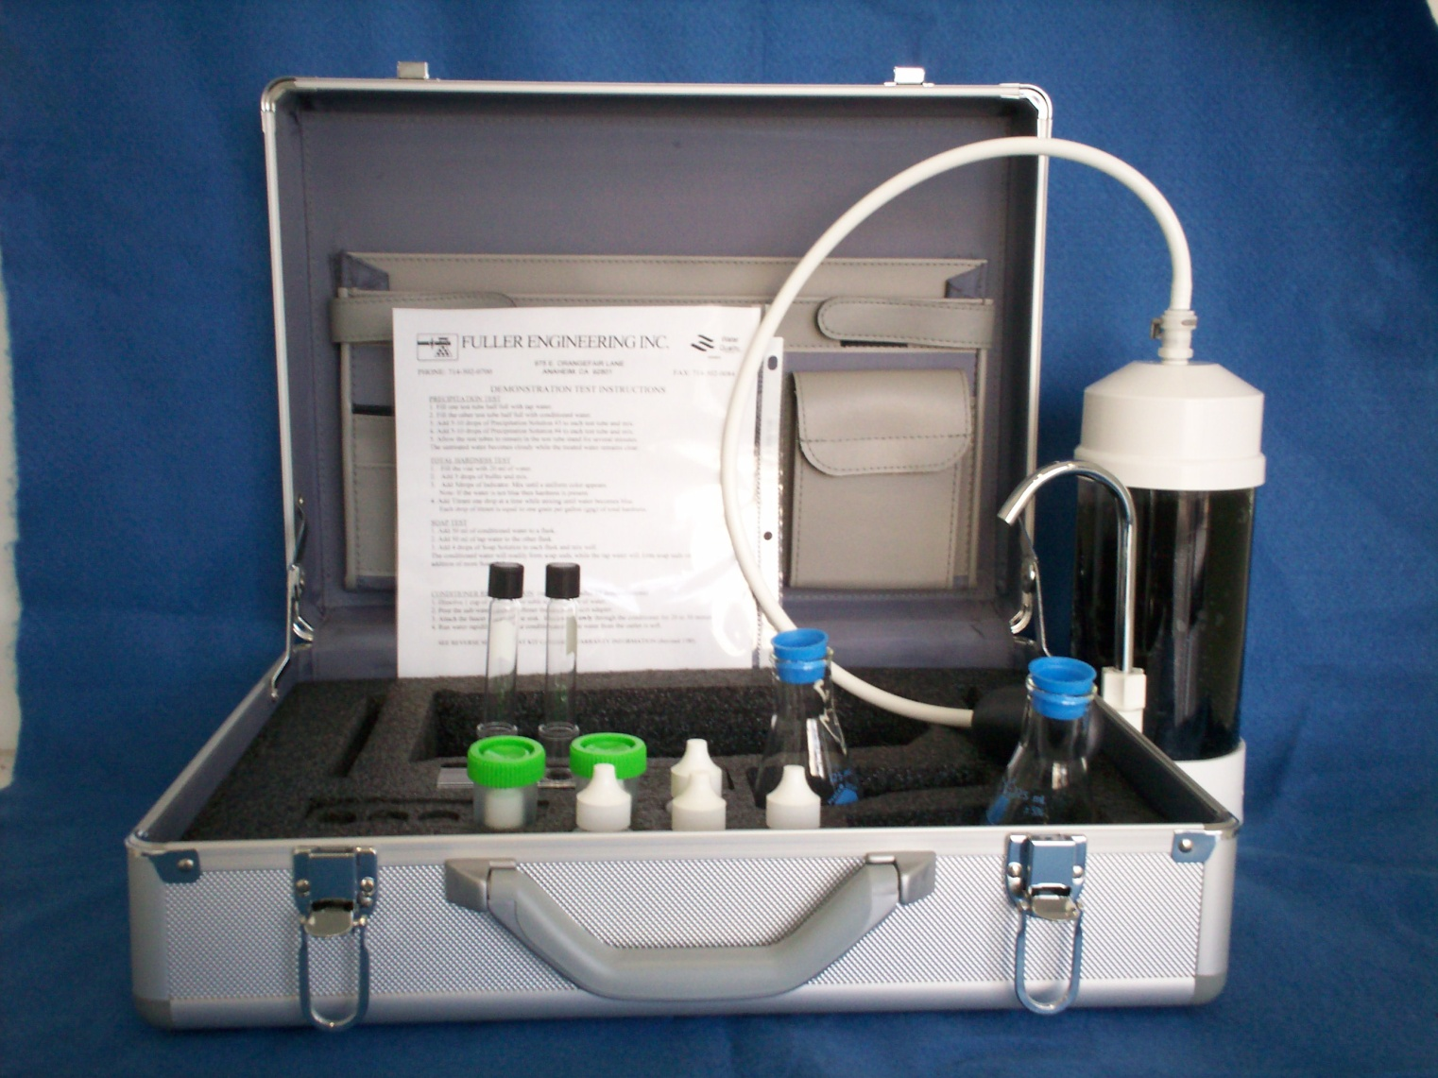
Why Water Testing ???

Slide 2
Quality of city water

Slide 3
How much water You drink per day….??

Slide 4
Do you know….

Slide 5
How is your Tap Water

Slide 6
What is hard water..?

Slide 7
Hardness chart by America Water Works Association

Slide 8
You will be surprise to know

Slide 9
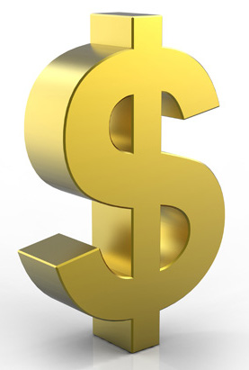
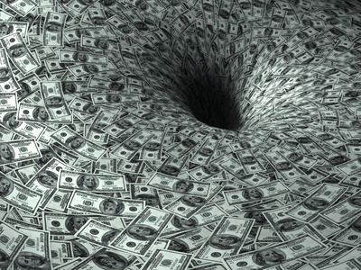
Hard Water
costs you
MONEY !!

Slide 10
How it costs you $$

Slide 11
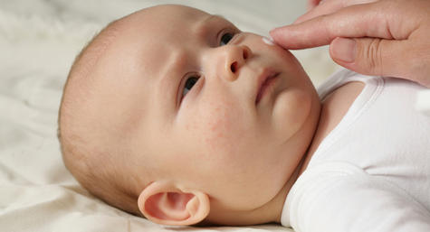
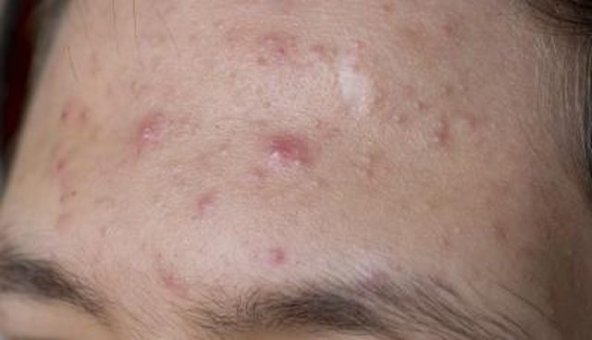
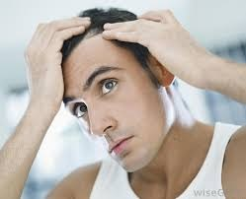
Effects on Hair & Skin

Slide 12
How can you save….

Slide 14
More savings

Slide 15
Current Situation

Slide 16
Benefits

Slide 17
First Financial Difference
Present situation per month WITHOUT Water Treatment System $ XXX
Upgrade situation per month WITH Water Treatment System
$XXX - $85
Saving per month $$$

Slide 18
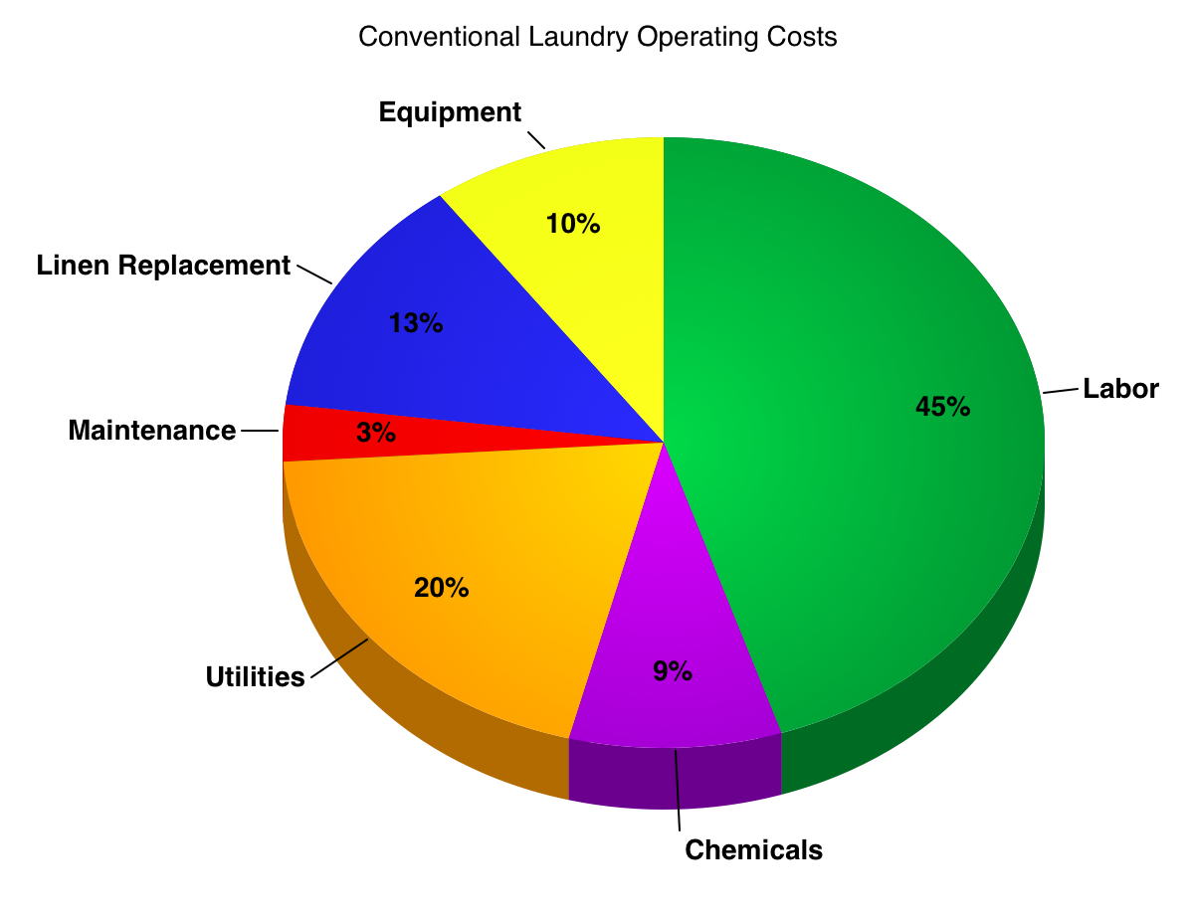
Benefits Pure wash

Slide 19
Second Financial Difference with PURE WASH PRO
Present situation per month WITHOUT Water Treatment System $ XXX
Upgrade situation per month WITH Water Treatment System
$XXX - $92
Saving per month $$$

Slide 20
Third Financial Difference with Tank-less Water Heater
Present situation per month WITHOUT Water Treatment System $ XXX
Upgrade situation per month WITH Water Treatment System
$XXX - $135
Saving per month $$$

